Slide 1
Parental trees

Slide 2
Outline
In this topic, we will
Define a parental tree
Consider an efficient implementation
Converting a parental tree to a node-based tree

Slide 3
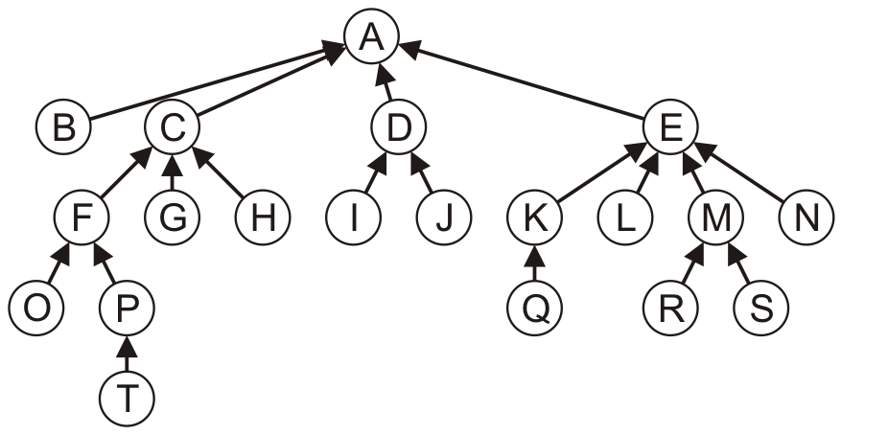
Definition
A parental tree is a tree where each node only keeps a reference to its parent node
Note, this definition is restricted to this course
Also known as a parent-pointer tree

Slide 4
Definition
This requires significantly less memory than our general tree structure, as no data structure is required to track the children

Slide 5
Implementation
A naïve implementation may also be node based:
template <typename Type>
class Parental_tree {
private:
Type element;
Parental_tree *parent;
public:
// ...
};

Slide 6
Implementation
Instead, generate an array of size n and associate each entry with a node in the tree
0 | 1 | 2 | 3 | 4 | 5 | 6 | 7 | 8 | 9 | 10 | 11 | 12 | 13 | 14 | 15 | 16 | 17 | 18 | 19
A | B | C | D | E | F | G | H | I | J | K | L | M | N | O | P | Q | R | S | T

Slide 7
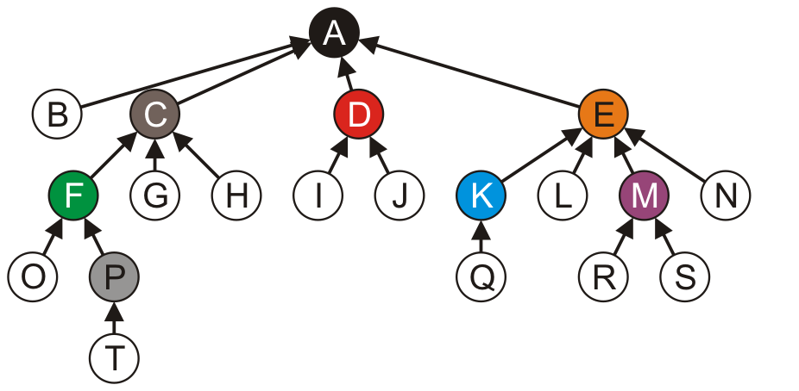
Implementation
Store the index of the parent in each node
The root node, wherever it is, points to itself
0 | 1 | 2 | 3 | 4 | 5 | 6 | 7 | 8 | 9 | 10 | 11 | 12 | 13 | 14 | 15 | 16 | 17 | 18 | 19
0 | 0 | 0 | 0 | 0 | 2 | 2 | 2 | 3 | 3 | 4 | 4 | 4 | 4 | 5 | 5 | 10 | 12 | 12 | 15
A | B | C | D | E | F | G | H | I | J | K | L | M | N | O | P | Q | R | S | T

Slide 8
Implementation
The memory requirements are quite small relative to our node-based implementation
0 | 1 | 2 | 3 | 4 | 5 | 6 | 7 | 8 | 9 | 10 | 11 | 12 | 13 | 14 | 15 | 16 | 17 | 18 | 19
0 | 0 | 0 | 0 | 0 | 2 | 2 | 2 | 3 | 3 | 4 | 4 | 4 | 4 | 5 | 5 | 10 | 12 | 12 | 15
A | B | C | D | E | F | G | H | I | J | K | L | M | N | O | P | Q | R | S | T

Slide 9
Implementation
In a tree, only one node will point to itself
0 | 1 | 2 | 3 | 4 | 5 | 6 | 7 | 8 | 9 | 10 | 11 | 12 | 13 | 14 | 15 | 16 | 17 | 18 | 19
0 | 0 | 0 | 0 | 0 | 2 | 2 | 2 | 3 | 3 | 4 | 4 | 4 | 4 | 5 | 5 | 10 | 12 | 12 | 15
A | B | C | D | E | F | G | H | I | J | K | L | M | N | O | P | Q | R | S | T

Slide 10
Converting to a Simple_tree structure
Converting the array-based parental tree structure back into a node-based general tree structure is relatively straight-forward:
int const n = 20;
int parent_array[n] = { 0, 0, 0, 0, 0, 2, 2, 2, 3, 3,
4, 4, 4, 4, 5, 5, 10, 12, 12, 15};
Simple_tree<Type> *root_node = nullptr;
Simple_tree<Type> *array = new Simple_tree<Type> *[n];
for ( int i = 0; i < n; ++i ) {
array[i] = new General_tree<Type>();
}
for ( int i = 0; i < n; ++i ) {
if ( parent_array[i] == i ) {
root_node = array[i];
} else {
array[parent_array[i]]->attach( array[i] );
}
}

Slide 11
Looking ahead
The parental tree representation is used in numerous places:
A similar structure is used for the disjoint set data structure used to store equivalence relations
Relevant operations are essentially Θ(1)
Storing the critical path for the topological sorting of a directed acyclic graph
Prim’s algorithm: storing a minimum spanning trees of a weighted graph
Dijkstra’s algorithm: storing the minimum paths in a weighted graph

Slide 12
Summary
This topic covered
The definition of a parental tree
Considered an efficient implementation
Considered converting back to a Simple_tree-based structure
Considered various uses

Slide 13
References
Wikipedia, http://en.wikipedia.org/wiki/Minimum_spanning_tree
These slides are provided for the ECE 250 Algorithms and Data Structures course. The material in it reflects Douglas W. Harder’s best judgment in light of the information available to him at the time of preparation. Any reliance on these course slides by any party for any other purpose are the responsibility of such parties. Douglas W. Harder accepts no responsibility for damages, if any, suffered by any party as a result of decisions made or actions based on these course slides for any other purpose than that for which it was intended.

